Slide 1
Course 3 Capstone
Data Collection

Slide 2
Finding the Middle (Adware Ad Clicks)
Mean, Median, and Mode help you compare data. Below, list the mean, median, and mode of the clicks in the provided data.
Mean: 60.38
Median: 60.00
Mode: 78

Slide 3
Finding the Middle (Adware Ad Conversions)
Mean, Median, and Mode help you compare data. Below, list the mean, median, and mode of the conversions in the provided data.
Mean: 5.98
Median: 6.00
Mode: 5

Slide 4
Standard Deviation
Determining variance in data helps you to look at data spread. Below, enter the standard deviation of the provided data.
Standard Deviation of Clicks: 14.37
Standard Deviation of Conversions: 1.63

Slide 5
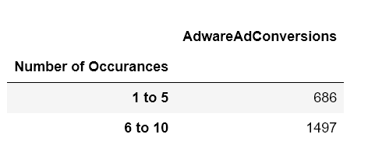
Frequency and Contingency Tables
Understanding how often something happens is important to understanding trends and patterns in your data. Create and insert a contingency table generated from your data.

Slide 6
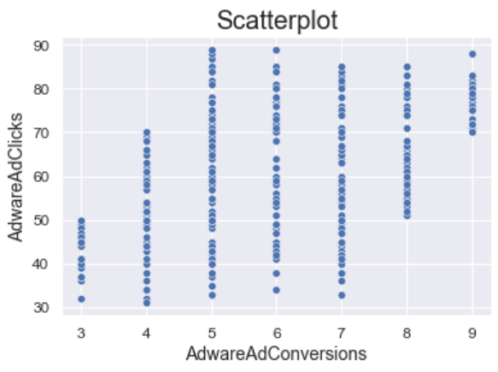
Scatter Plot
Understanding the relationships between data is important to understanding trends and patterns. Create and insert a scatter plot generated from your data. Then, include the input the correlation coefficient as well.
Scatter Plot of your data:
Correlation coefficient: 0.45

Slide 7
End of Section 1

Slide 8
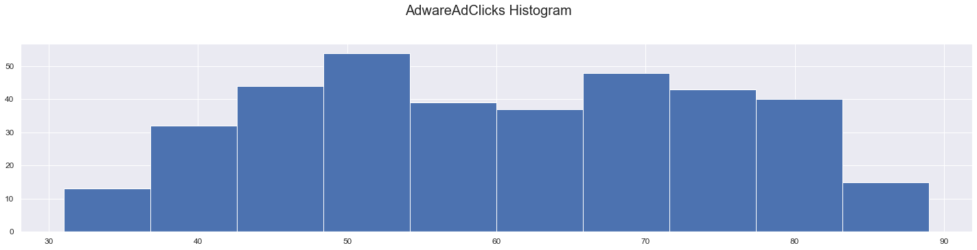
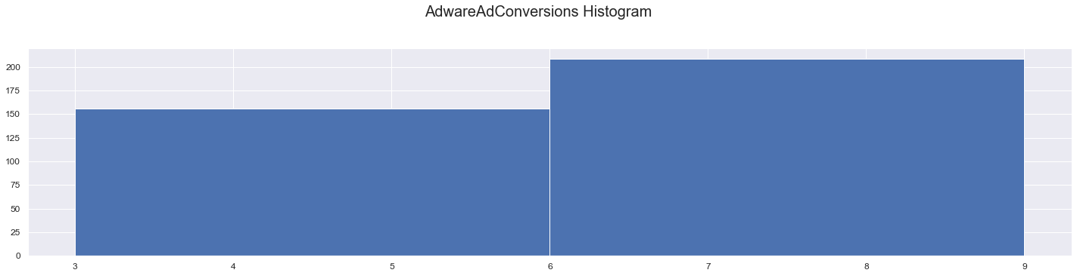
Sample Type
It’s important to understand the sample you’re using in your analysis. Fill in the information below about the sample you have received:
Histogram of your clicks data:
Histogram of conversions data:

Slide 9
Sample Type
It’s important to understand the sample you’re using in your analysis. Fill in the information below about the sample you have received:
Does the clicks data have a normal distribution? No
Does the conversions data have a normal distribution? No

Slide 10
Variable Types
Determining the types of variables your working with is an important skill. Below, list the variables from your data that are:
Quantitative:
Continuous: AdWords Ad Views, AdWords Ad Clicks, Cost per AdWords Ad,
AdWords Click-Through Rate, AdWords Conversion Rate, AdWords Cost per Click
Discrete: None
Qualitative:
Nominal: None
Ordinal: None

Slide 11
End of Section 2

Slide 12
Question and Hypothesis
The question you hope to answer and your hypothesized answer are necessary to complete an analysis. Answer the following questions
What is your hypothesis based off the evaluation question?
Are the number of conversions in Facebook greater than AdWare Ad when more advertising is done there?

Slide 13
Question and Hypothesis
The question you hope to answer and your hypothesized answer are necessary to complete an analysis. Answer the following questions
What is your independent variable? Cost per Facebook Ad
What is your dependent variable? Facebook Ad Conversions

Slide 14
Running a Test
With your question and hypothesis ready, run the test on the two sets of data. Fill in the information below.
Mean number of Facebook conversions: 11.74
Mean number of Adware conversions: 5.98
p-Value: 9.34 exp(-134)

Slide 15
Hypothesis
After running the test, was your hypothesis proven correct?
Do your findings support a null or an alternative hypothesis? xx
What’s your conclusion about your main hypothesis? Is there a difference, and is it what your hypothesis predicted?
Since the p-value calculated is less than 0.05, H0 is rejected, and H1 is accepted.
There is a statistical difference between Facebook and AdAware Ad Conversions.

Slide 16
End of Section 3

Slide 17
Determining a Model
Based off what you know so far, you’ll need to determine if your data meets the assumptions for a chosen model. Including:
Which model makes the most sense to use and why?
Simple Linear Regression is chosen due to one independant and one dependant variable. Both variables are normally distributed.

Slide 18
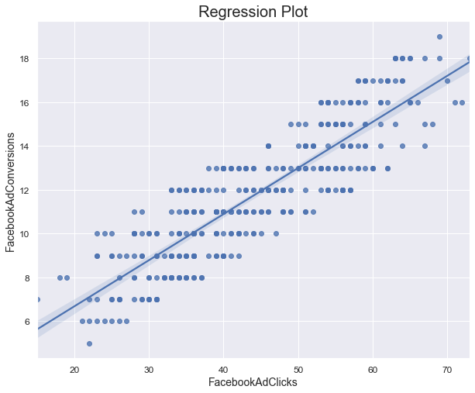
Modeling
Finally, include a visualization of your complete model.

Slide 19
End of Section 4

Slide 20
Final Insights
Now, knowing what you do about the results of your test, what are the final insights that you would share with your client? What did you learn and what would you recommend? Is there anything you would do differently next time?
From hypothesis testing done, we have found out that Facebook Ad has better conversion results than AdWare Ad.
We recommend the company use Facebook Ad to advertise and market their products and services to customers.
We can do several more comparisons with other equivalent online advertisements to find out its effectiveness.

